Slide 1
An Osteopathic Ground Game
Shawn R. Kerger, DO, FAOASM
Associate Professor, OMM Dept, OU-HCOM – Dublin
Medical Director, OMM Department, Doctors Hospital
Medical Director, Peter E. Johnston, DO Simulation and Education Center
Richard Schuster, DO
Department Chair of Primary Care, Marian University College of Osteopathic Medicine

Slide 2
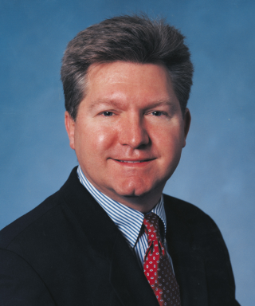
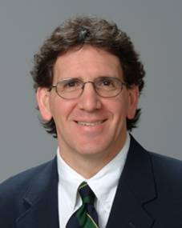
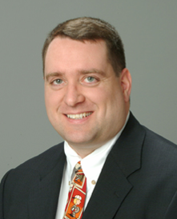
P. Gunnar Brolinson, DO, FAAFP, FAOASM
Paul Tortland, DO, FAOASM
Albert Kozar, DO, CAQSM

Slide 3
Osteopathic Principles
The Osteopathic principles proposed by AT Still which most directly relate to our purposes here are:
“When all parts of the body are in line we have health.”
“When complete, he is…in size & form to suit the duties he may have to perform.”
“You as Osteopathic machinists …adjust the abnormal condition, in which you find the afflicted. Nature will do the rest.”

Slide 4
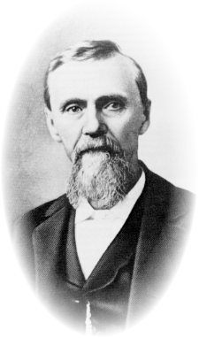
Osteopathic Principles
Or as restated by the faculty of the Kirksville College of Osteopathy & Surgery in 1953:
The body is a unit.
Structure & function are reciprocally interrelated.
The body is self-healing.

Slide 5
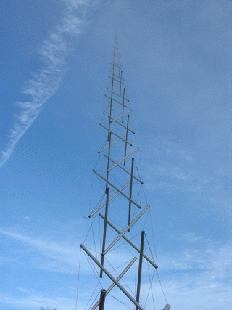
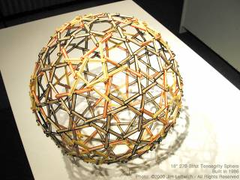
Tensegrity
Still in development
A self-stabilizing system in which tension is continuously transmitted across all elements
Stability from distribution & balancing of mechanical forces
Triangulated structures form the basis for this system
Tetrahedron
Octahedron
Icosahedron

Slide 6
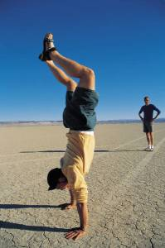
Functional Anatomic Concepts: Muscle
Kinetic chain - the sequencing of individual body segments & joints to accomplish a task
Generally functions from a base of support proximally & then proceeds distally, but this is entirely dependant on the task at hand:
a bench press would follow the aforementioned path
a pushup reverses the mechanics even though the muscles engaged are similar, if not identical

Slide 7
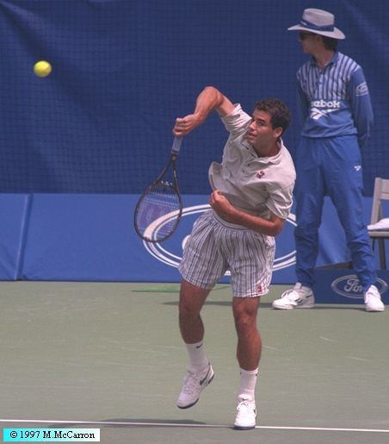
Kinetic Chain
‘Catch-up’ phenomenon
- compensation for dysfunction in the earlier (temporally speaking) components of the chain is not as productive a motion & can lead to injury in the later components, as the tissues either cannot handle the load or fire inappropriately
- Kibler

Slide 8
Compensation, Dysfunction and Motor Patterns
Compensation can be a good thing – allows for us to perform around a hindrance.
Or, it can result in dysfunction in which we are now impaired to a greater degree perhaps than the original hindrance!

Slide 9
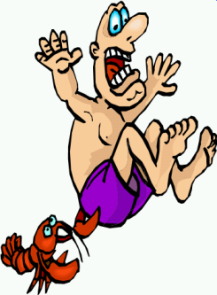
Disturbed Motor Function
Most important symptom ... PAIN!
The area of the pain may not tell you where the problem is…
Must learn to identify & treat underlying somatic dysfunction.

Slide 10
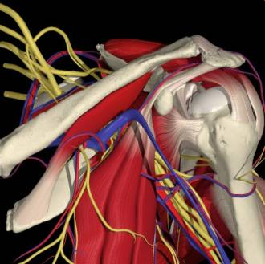
Somatic Dysfunction
Impaired or altered function of related components of the somatic (body framework) system: skeletal, arthrodial, & myofascial structures, & related vascular, lymphatic, & neural elements.

Slide 11
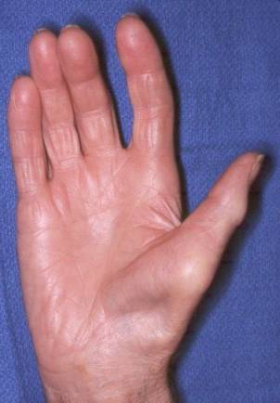
Dysfunction
Logically, lack of use of a tissue (either due to injury, improper pain management, altered or improper technique, joint or soft tissue restrictions, etc.) will reverse the normal physiological processes.
Bone will become less dense
Joints will stiffen & ligaments will shorten
Muscles will atrophy & neuromuscular control will be negatively altered
Metabolic processes will revert to a lower energy (basal metabolic rate will drop), yet less exercise-tolerant, condition

Slide 12
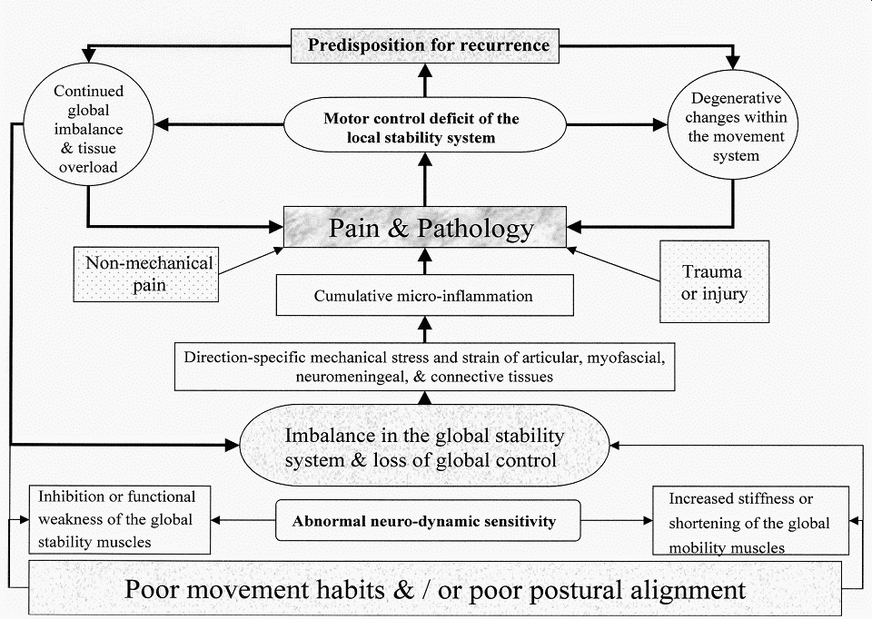

Slide 13
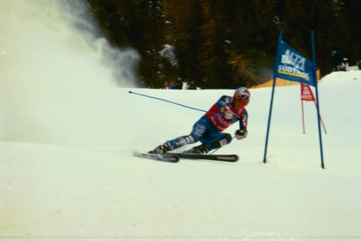
Gravitational Strain
Three Cardinal Bases of Support
The standing surface
The feet
The base of the sacrum

Slide 14
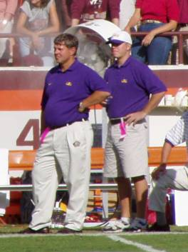
Gravitational Strain
Posture
Size , shape & attitude of the musculoskeletal system.
Departure from “ideal” posture results in increased mechanical stress.
Gravity never has an “off” day.

Slide 15
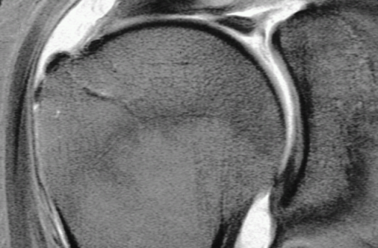
Functional Biomechanical Exam
We’ll assume you know how to diagnose the “itis” pathologies
Now that we know where the problem is, the issue becomes why is it there?

Slide 16
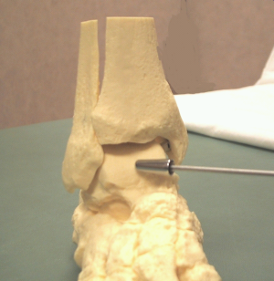
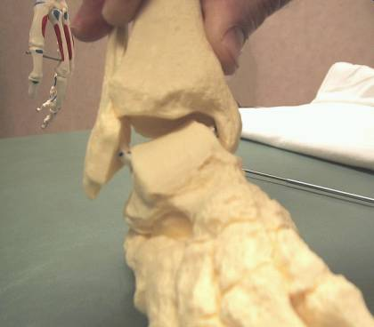
Inversion Ankle Sprain

Slide 17
Inversion Ankle Sprain
Typically with plantar flexion
Thin posterior portion of talus offers little ankle stability, relying primarily on soft tissue support
Peroneal muscles eccentrically loaded rapidly
Weight of body coming down ‘jams’ talus into the crural (distal tib/fib) articulation

Slide 18
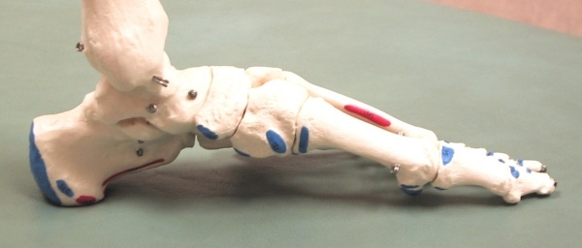
Navicular Dysfunction
Peroneus longus tendon inserts on medial cuneiform bone - with inversion, it pulls inferiorly & “collapses” the arch via the navicular-cuneiform ligament
Can be acute or chronic
Can also occur due to dysfunction elsewhere (hamstrings, sacrum, etc.)
Peroneus Longus Insertion
Spring Ligament

Slide 19
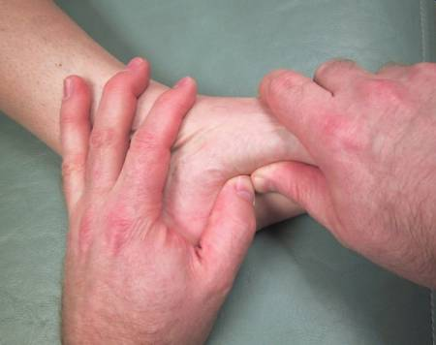
Navicular Dysfunction
Palpation of arch reveals a more prominent (& usually tender) navicular bone in arch medially
Pronation may be noticeable in standing examination

Slide 20
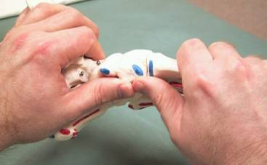
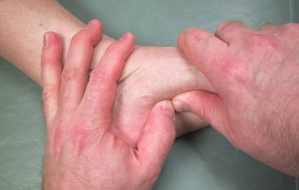
Navicular Dysfunction
Restore arch by gapping superior aspects of navicular & cuneiform bones & applying plantar → dorsal pressure
Can be done with one rapid action or with slow steady pressure
Recheck findings

Slide 21
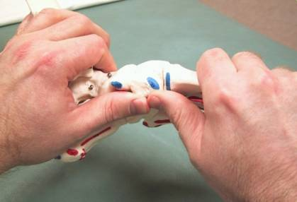
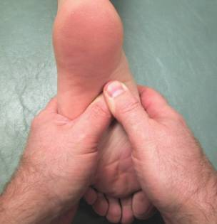
Navicular Dysfunction
Can also be treated successfully with strain-counterstrain
Find most tender point in tissues over navicular
With pt prone, greatly flex forefoot & invert/evert forefoot until tender point 70% (& can go for more) gone
Maintain position with pt stabilized passively for 90 seconds
Return (passively) to neutral
Recheck findings

Slide 22
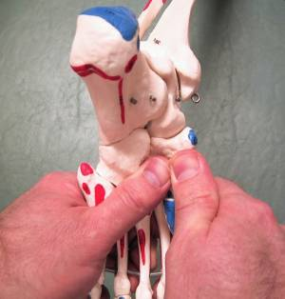
Navicular “Whip”
With patient prone & leg relaxed, place thumbs over plantar aspect of navicular bone
While plantar flexing the foot, apply a valgus motion to the ankle as you ‘snap’ or ‘whip’ the navicular bone dorsally
Recheck your findings

Slide 23
Navicular Dysfunction

Slide 24
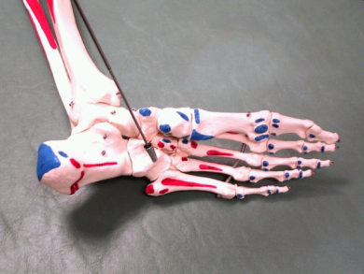
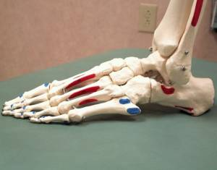
Cuboid Dysfunction

Slide 25
Cuboid Dysfunction
Palpation of arch reveals a more prominent (& usually tender) cuboid bone in arch laterally
Pronation may be noticeable in standing examination, but due to guarding, patient may exhibit supination

Slide 26
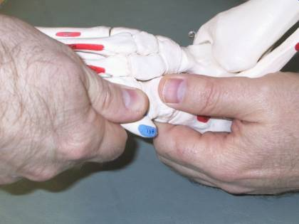
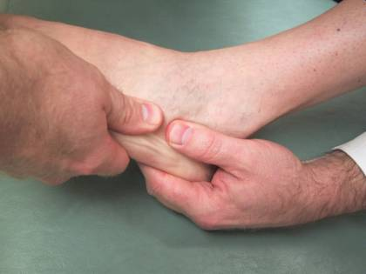
Cuboid Dysfunction
Can be treated in a mirror fashion as navicular, but also may be addressed by grasping cuboid snugly & ‘chalking’ the 5th metatarsal head onto the cuboid gently, or the cuboid onto the calcaneus.

Slide 27
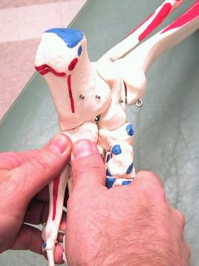
Cuboid Dysfunction
Can also be treated successfully with strain-counterstrain
Find most tender point in tissues over cuboid
With pt prone, greatly flex forefoot & invert/evert forefoot until tender point 70% (& can go for more) gone
Maintain position with pt stabilized passively for 90 seconds
Return (passively) to neutral
Recheck findings

Slide 28
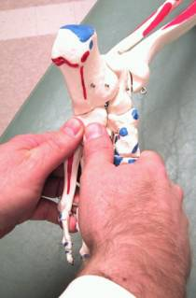
Cuboid “Whip”
With patient prone & leg relaxed, place thumbs over plantar aspect of cuboid bone
While plantar flexing the foot, apply a varus motion to the ankle as you ‘snap’ or ‘whip’ the cuboid dorsally
Recheck your findings

Slide 29
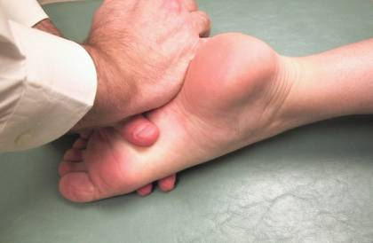
Cuboid Dysfunction

Slide 30
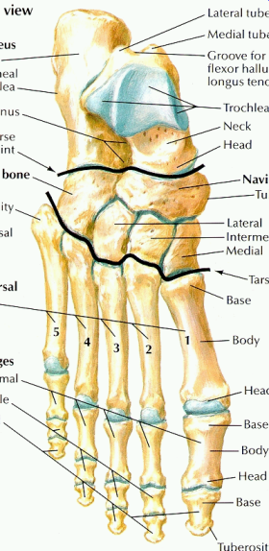
Articular Techniques for Talus
Commonly restricted anteriorly, or impacted. May also present as an anterior fibular head!
Usually secondary to a traumatic inversion mechanism at the ankle, but can also be due to chronically tight posterior calf muscles.
Can be associated with plantar fasciitis.
Pt will complain of anterior talar pain or ‘jamming’ with attempted dorsiflexion, & possibly of reduced calf stretch when attempted.

Slide 31
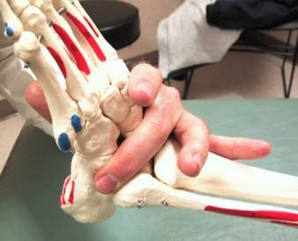
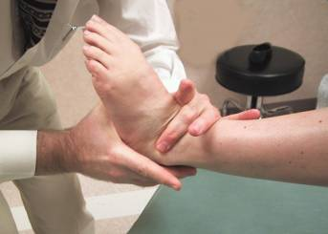
Articular Techniques for Talus
Place ipsilateral middle or ring finger over the superior aspect of the talus, below the tib-fib joint.
Dorsiflex ankle to the barrier, while cradling the calcaneus with the contralateral hand. You may fine tune with inversion & eversion to maximize dorsiflexion.
With the patient relaxed, either:
tug the foot quickly with a moderate force in a caudal direction,
or with a traction force caudally, rock the calcaneus & talus as a unit in an inversion/eversion plane.

Slide 32
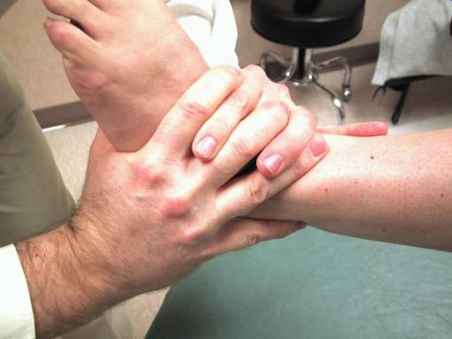
Talar Tug – Alternate Hold
Need to pull & dorsiflex at the same time – makes a ‘J’ pattern movement when viewed this way

Slide 33
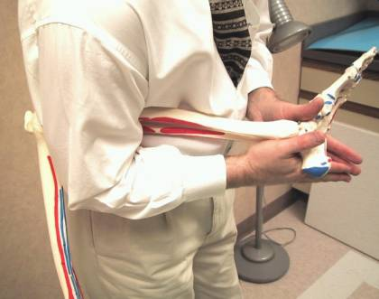
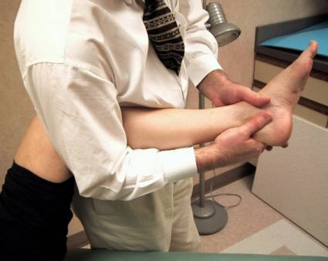
Talar Release
Pt supine with knee & hip flexed to 90º & hip slightly abducted, nestle your elbow against the mid-hamstring area while forming a ring with your thumbs & forefingers around the talus.
Slowly, but firmly, flex the knee while maintaining the ring around the talus. You should feel a traction force building.
Maintaining the tension, either exert a quick thrust with the talus or gently rock the talus into dorsiflexion with a little inversion/eversion until you feel a release, pop, or clunk.

Slide 34
Plantar fasciitis - the problem:
Too much tension on the plantar fascia. Why?
Arches not able to support themselves:
Navicular rotated
Weak intrinsic foot muscles
Weak or fatigued tibialis posterior, flexor digitorum longus, flexor hallucis longus
Tightness of Achilles

Slide 35
Differential diagnosis
Fat pad contusion/atrophy
Achilles tendonitis
Retrocalcaneal bursitis
Subcalcaneal bursitis
Rupture of plantar fascia
Medial calcaneal nerve entrapment
Stress fracture of the calcaneus
Tarsal tunnel syndrome (posterior tibial nerve)
Enthesopathy (seronegative spondyloarthropathies)
Paget’s disease
S1,2 radiculopathy

Slide 36
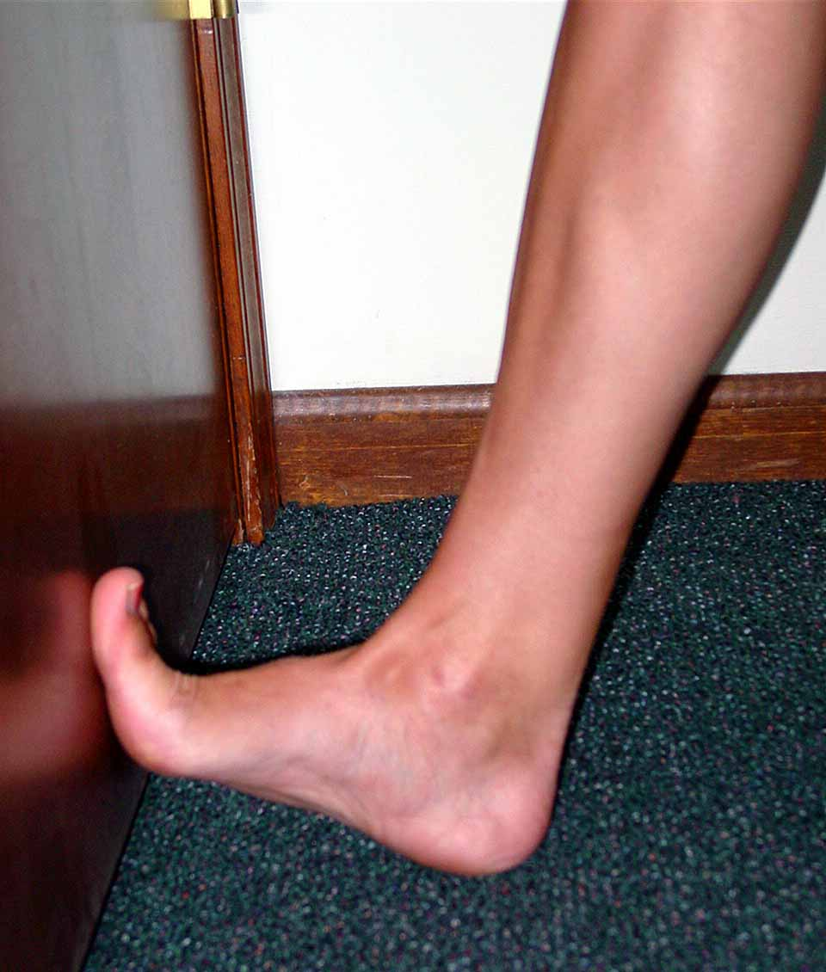
Standard treatment
Relative rest
Stretching
Intrinsic foot muscle strengthening
Physical therapy
Injection
Tension night splint
Orthotics
Surgery

Slide 37
What does an osteopath offer?
Does being an osteopath bring anything else to the table?
Understanding the functional anatomy, and dysfunctional physiology, might lead to improved results.
Therefore, what is the function of the anatomy? How may it be influenced? Does this change our treatment? How does it influence our standard treatment.
I would argue that largest benefit comes from an osteopathic understanding of the problem.

Slide 38
The osteopathic advantage
Therefore, the goal of treatment must be to re-establish normal function:
Maintenance of the medial arch
Relieve pressure from the ligaments
OMT, arch support
Improve strength of intrinsic foot muscles
exercises
Correct tightness of the Achilles
OMT, stretching
Improve proprioceptive function
OMT, specific proprioceptive retraining
But don’t forget that there is still pathology that must heal!

Slide 39
Arches

Slide 40
Arches: deep ligaments
Notes:
Long and short plantar ligaments
Calcaneonavicular ligament (spring)
Ramification of tibialis posterior

Slide 41
Intrinsic foot muscles
Notes:
Plantar fascia
Flexor digitorum brevis (splits to allow tendon of FDL to pass through, then reunite, then split again to attach to slides of toes), adductor digiti minimi, abductor hallucis.
Flexor digitorum accessorius: from the medial and lateral tuberosities to insert on the tendon slips of the flexor digitorum longus tendons just proximal to their divergence into the toes.
Abductor hallucis: flexion and abduction—if you do this, you will see that the medial arch height is increased
Abductor digiti minimi:

Slide 42
Tibialis posterior, flexor hallucis longus, flexor digitorum longus

Slide 43
Achilles Tendon

Slide 44
The treatment
Regardless of how you choose to affect the problem, certain things must be consistently done in order to treat the problem, and prevent its recurrence.
Remember that there is pathology here.
Inquire regarding changes in activity, footwear:
Often patients present after it has been present for months—ask specifically.
Look at the shoes and the insoles.

Slide 45
Common aspects of treatment
You must take pressure off the plantar fascia:
Easiest way to do this is with a heel lift:
Typically 5-10mm is sufficient.
Treat both sides.
Stretch the Achilles tendon, both gastrocnemius and soleus.
Stretch the plantar fascia.
Strengthen the intrinsic foot muscles.

Slide 46
Unload the plantar fascia
Very important to relieve the tension on the plantar fascia.
Can be done multiple ways, but heel lift is often easiest:
This drops the forefoot during weight bearing, shortening the distance between the metatarsals and calcaneus
Secondarily relieves tension on the Achilles
Should be done from a horizontal, not sloping (such as a high-heeled shoe would do), position.

Slide 47
Stretch the Achilles tendon
Possibly the most important aspect of treatment.
Remember to stretch both gastroc (knee straight) & soleus (knee bent)
Stretches should be held for 20-30s, repeated three times, both sides, regardless of symptoms.
Consider using a step &/or activated stretching (muscle energy)

Slide 48
Plantar fascia stretch
Direct stretching of plantar fascia is often recommended
I am not always sure how beneficial this is, or if the therapeutic benefit is really in stretching the fascia, or in some of the associated muscles supporting the arch.
Stretch held same as previous ones.

Slide 49
Strengthen intrinsic foot muscles
I find this very helpful in reconditioning muscles to help support the arch.
Does more than just intrinsic muscles, also includes the flexor hallucis longus, flexor digitorum longus, and maybe tibialis posterior.

Slide 50
OMT: navicular/cuboid
Correct dysfunction of the arch, especially the navicular, which tends to be rotated medially.
Functional approach:
Start from position of ease.
Add compressive force.
Take joint to, and through, the original barrier, maintaining the compressive force.

Slide 51
OMT: tibiotalar joint
Often also restricted with talus held in relatively valgus position.
Many ways to do this: this is an articulatory technique:
Contralateral elbow in popliteal fossa
Hand grasp calcaneus and anterior process of talus.
Lean cephalad, elbow acting as fulcrum to distract the talus from the mortise.
Gently rock the talus until articulation and release occurs.

Slide 52
OMT: tibial torsion
Notice that we are working up the kinetic chain. Obviously any somatic dysfunction should be treated, especially in the lumbar spine and pelvis.
Functional technique:
Start from position of ease, typically ext rot.
Apply compressive force.
Move tibia to and through barrier while extending the knee.

Slide 53
Fascial stripping
This is something that has been modified from Steven Typaldos, DO.
It is very painful, but very effective, and they often stand up feeling much better.
Treatment is done once per week, and typically takes ~6 treatments, sometimes less.

Slide 54
Fascial stripping

Slide 55
So what do we do?
Make sure it is plantar fasciitis!
Treat the existing somatic dysfunction on the first visit.
Heel lift.
HEP consisting of stretching and strengthening as described.
Then either:
Fascial stripping protocol
Injection protocol

